Slide 1
LEGAL CULTURE AND MEDIEVAL LEGISLATION IN THE FORMATION OF POLITICAL MODERNITY IN CONTEMPORARY SPAIN
Prof. Dr. Dr. Guillermo Vicente y Guerrero
Workshop Medieval Legislation and Modernity after 1850, June 14th to June 16 th 2023, Oslo

Slide 2
LEGAL CULTURE AND MEDIEVAL LEGISLATION IN THE FORMATION OF POLITICAL MODERNITY IN SPAIN
Prof. Dr. Dr. Guillermo Vicente y Guerrero
University of Zaragoza (Spain)
LEGAL CULTURE AND MEDIEVAL LEGISLATION IN THE POLITICAL MODERNITY IN SPAIN
Prof. Dr. Dr. Guillermo Vicente y Guerrero

Slide 3
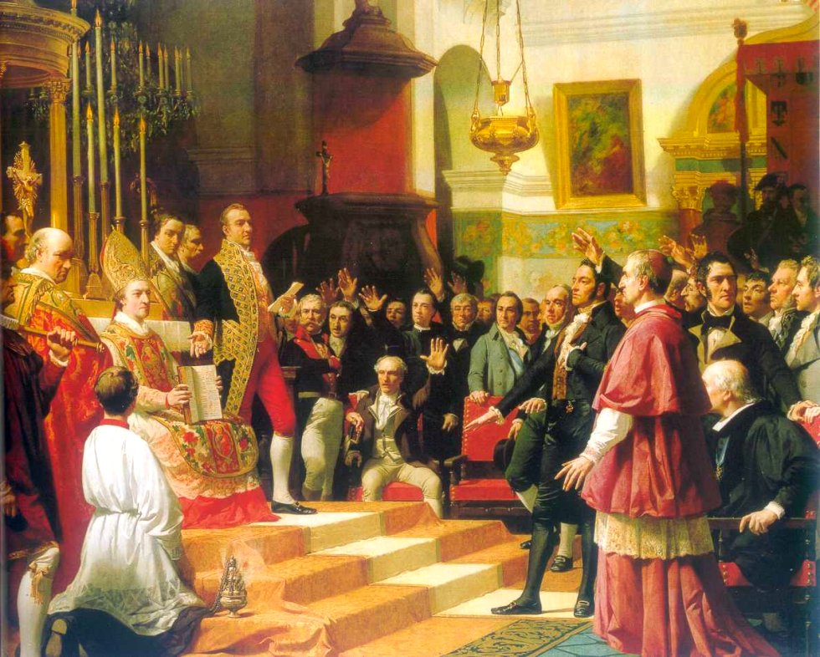
THE MAIN PURPOSE OF THIS CONFERENCE
In the construction of the new legal order in Spain in the 19TH century was it necessary to resort to the old medieval legislation?
It was an inalienable point of departure. Two main sources of inspiration will be followed:
  The Visigoths.
  The three Medieval Kingdoms (Castile, Aragon & Navarre).
Juramento de las Cortes de Cádiz, José Casado del Alisal, 1863.
LEGAL CULTURE AND MEDIEVAL LEGISLATION IN THE POLITICAL MODERNITY IN SPAIN
Prof. Dr. Dr. Guillermo Vicente y Guerrero
3

Slide 4
CONTENTS
I. Introduction. A brief historical overview
II. Tradition versus modernity in the political legal construction of the new Spanish liberal national state
III. Codification versus anti-codification
IV. Conclusion
V. Selected bibliography
LEGAL CULTURE AND MEDIEVAL LEGISLATION IN THE POLITICAL MODERNITY IN SPAIN
Prof. Dr. Dr. Guillermo Vicente y Guerrero

Slide 5
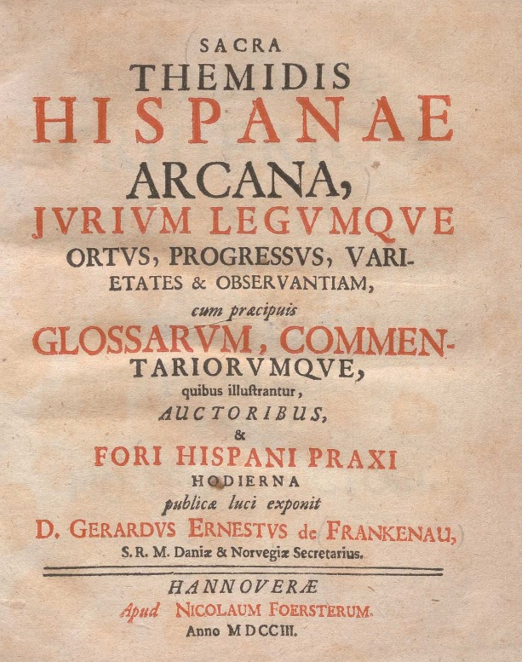
FORALISM
From a legal perspective, it can be stated that Spain has been a federal country.
In 1703, in Hamburg, G. E. de Frankenau published Sacra Themidis Hispanae arcana. Conceiving the foral component as an element consubstantial to the logic of the Hispanic monarchy.
Foralism, the most important legal-political features of the «non-Castilian Spain», made up of the countries of the old Crown of Aragon (Aragon, Catalonia, Valencia and Majorca) as well as Navarre and the Basque Provinces.
Sacra Themidis Hispaniae Arcana, G.E. Frnkenau ,1703.
LEGAL CULTURE AND MEDIEVAL LEGISLATION IN THE POLITICAL MODERNITY IN SPAIN
Prof. Dr. Dr. Guillermo Vicente y Guerrero
5

Slide 6
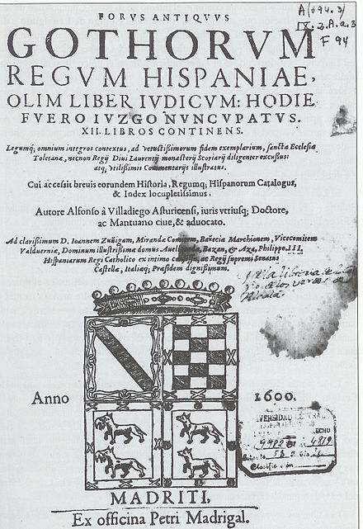
VISIGOTHS
They entered the Iberian Peninsula in 414 with their king Ataulfo to put an end to several centuries of Roman domination, the first people who managed to build a unified state over Iberian Peninsula.
The reconversion of the invaders to Christianity, by King Recaredo in the year 589 in the III Council of Toledo.
The legislative work carried out by King Recesvinto, who approved in the year 654 the so-called Liber Iudiciorum, twelve books, in imitation of the Code of Justinian, it is considered the great legal work of the Visigothic kingdom. In 1241 it would be translated to be granted as a charter, called Fuero Juzgo.
Fuero Juzgo, 1600.
LEGAL CULTURE AND MEDIEVAL LEGISLATION IN THE POLITICAL MODERNITY IN SPAIN
Prof. Dr. Dr. Guillermo Vicente y Guerrero
6

Slide 7
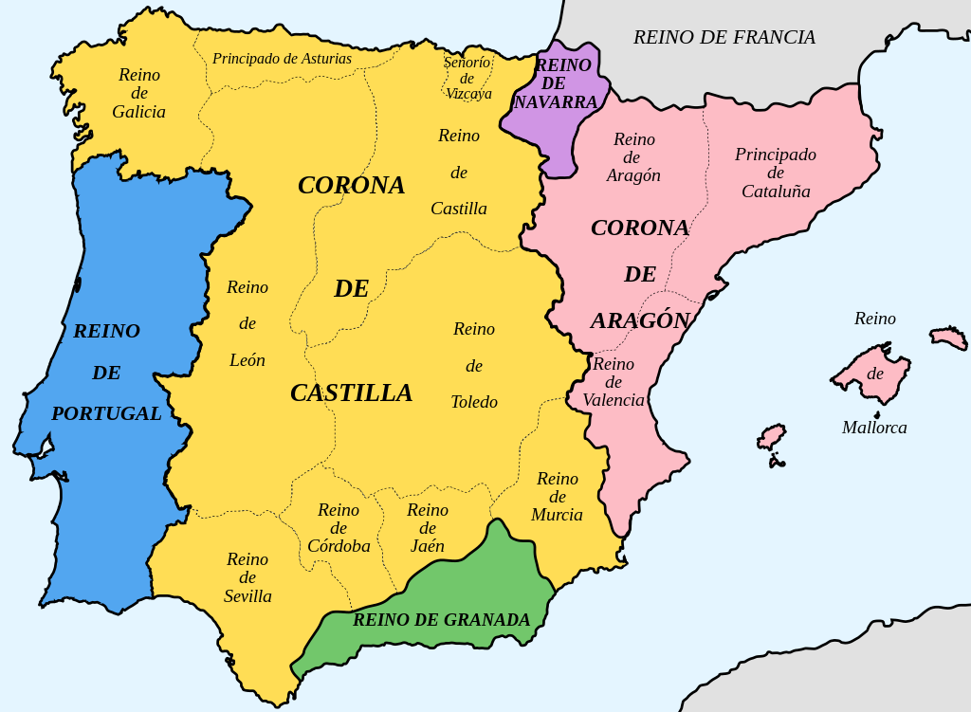
THREE MEDIEVAL KINGDOMS
After the Muslim invasion in 711, following their victory at the Battle of the River Guadalete, the Arabs settled in a large part of the Peninsula.
The three main medieval kingdoms, Aragon, Castile and Navarre, drew up local fueros (laws containing privileges and exemptions) to regulate the historical processes of the reconquest and repopulation.
LEGAL CULTURE AND MEDIEVAL LEGISLATION IN THE POLITICAL MODERNITY IN SPAIN
Prof. Dr. Dr. Guillermo Vicente y Guerrero
7

Slide 8
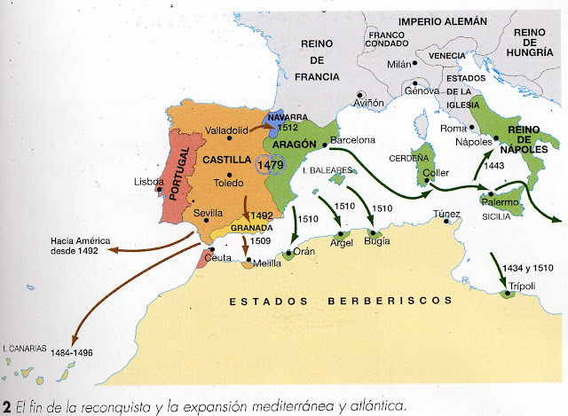
Throughout the Middle Ages in Spain there were two great Crowns: Aragon and Castile.
When in 1479 the dynastic union of both was consummated, their territories maintained their own laws and institutions, following different paths under the authority of the same king.
Aragon became strong in the Mediterranean, while Castile crossed the Atlantic, discovering a new continent in 1492.
TWO MODERN CROWNS
LEGAL CULTURE AND MEDIEVAL LEGISLATION IN THE POLITICAL MODERNITY IN SPAIN
Prof. Dr. Dr. Guillermo Vicente y Guerrero
8

Slide 9
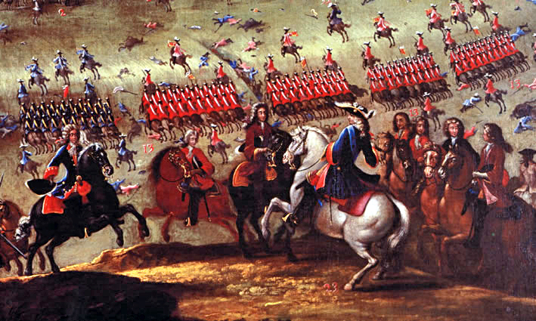
SPANISH CIVIL WAR
When Charles II, the last king of the Habsburg dynasty, died in 1700, a dynastic dispute began between the two main pretenders to his succession, the Archduke Charles and the Bourbon Philip of Anjou. It was the first Spanish civil war.
A new legal order arose and the so-called Nueva Planta Decrees were imposed by the execrable means of arms on the four territories of the Crown of Aragon as a reprisal of war.
Their foral regimes was reduced to private law, being converted into simple provinces of the Hispanic monarchy.
Batalla de Almansa, Ricardo Balaca, 1862.
LEGAL CULTURE AND MEDIEVAL LEGISLATION IN THE POLITICAL MODERNITY IN SPAIN
Prof. Dr. Dr. Guillermo Vicente y Guerrero
9

Slide 10
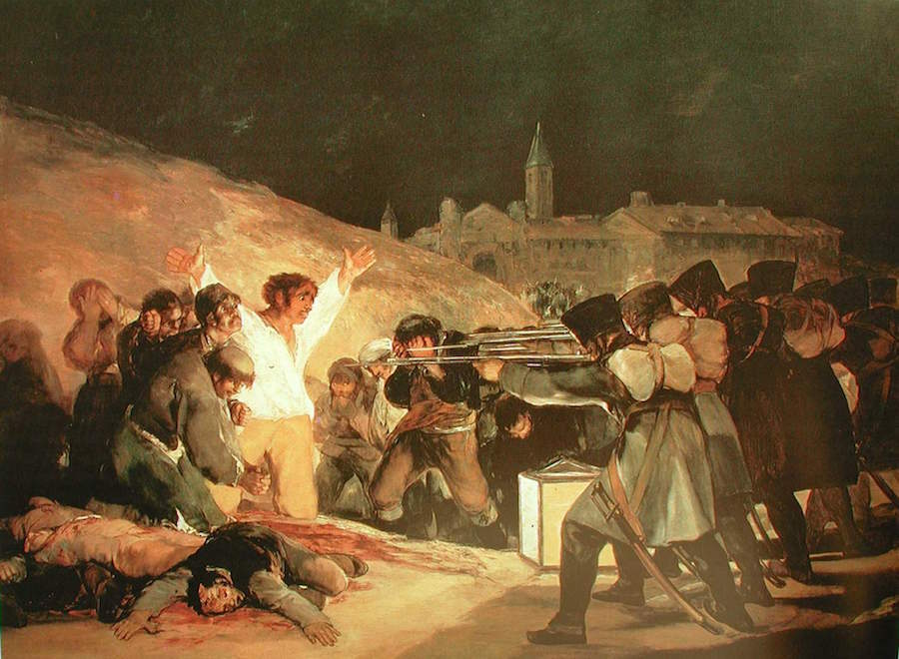
SPANISH INDEPENDENCE WAR
The War of Independence (1808-1814) offered the appropriate theater to proceed to the re-foundation of the State and the Spanish nation, giving rise to as many possible Medievos as demands provoked by the new political situation.
The heroic Spanish Middle Ages tried to oppose French modernity, which was said to have betrayed its own historical patriotic essences.
The denial of all French influence, in a context of war, however, hid the fact that some of the main postulates of the French revolutionaries directly influenced the Spanish revolutionaries.
Los fusilamientos del 2 de mayo, Francisco de Goya, c.1814.
LEGAL CULTURE AND MEDIEVAL LEGISLATION IN THE POLITICAL MODERNITY IN SPAIN
Prof. Dr. Dr. Guillermo Vicente y Guerrero
10

Slide 11
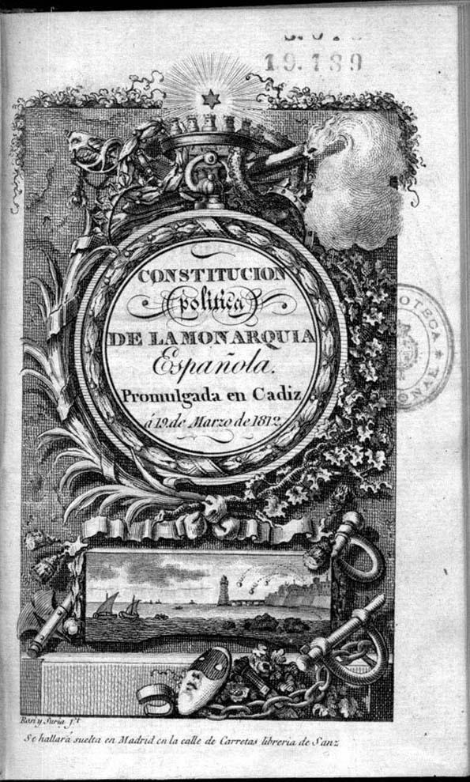
PRELIMINARY DISCOURSE OF CADIZ CONSTITUTION
«Nothing in its project that is not already consigned in the most authentic and solemn way in the different bodies of Spanish legislation... the fundamental laws of Aragon, Navarre and Castile».
The medieval world was the fundamental stone on which to build the new constitutional edifice.
In the Preliminary Discourse, the Fuero Juzgo plays a major role as a source of legitimation for the constitutional text itself.
The discourse was writed by José Espina & Agustín Argüelles.
Spanish Constitution of 1812.
LEGAL CULTURE AND MEDIEVAL LEGISLATION IN THE POLITICAL MODERNITY IN SPAIN
Prof. Dr. Dr. Guillermo Vicente y Guerrero
11

Slide 12
TWO GREAT DISCURSIVE MODELS
Two great discursive models were to be present: the «Castilian-centrist» and that of the «Spain of the provinces». These two discourses focused on the importance of the influence of medieval legislation. Both discourses shared three common elements:
  The belief in the existence of a previous foundational nation, which would correspond to the Visigothic Kingdom of Toledo.
  The existence of a Cortes or Parliament, with its limitations and particularities in each territory, which had been key elements in the juridical and political histories of the three medieval Spanish kingdoms: Aragon, Castile and Navarre.
  The pactist nature of the political regime, initiated through the so-called «oath of the kings», an indisputable starting point for the official recognition of a fundamental medieval legislation.
LEGAL CULTURE AND MEDIEVAL LEGISLATION IN THE POLITICAL MODERNITY IN SPAIN
Prof. Dr. Dr. Guillermo Vicente y Guerrero
12

Slide 13
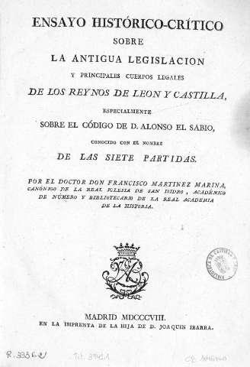
CASTILIAN DISCOURSE
Sought to identify national law with Castilian law: Fuero Juzgo & Siete Partidas.
Francisco Martínez Marina, who in his Ensayo histórico-crítico sobre la legislación de los reinos de León y Castilla, identified the history of Spain with the history of Castile.
Antonio Ranz Romanillos presented a very significant Reunión de las leyes fundamentales de la Monarquía Española in which he outlined from the Visigothic laws to those of Felipe V, including exclusively the Castilian codes of law: Fuero Juzgo, Siete Partidas, Fuero Viejo, Fuero Real, Ordenamiento de Alcalá, Ordenamiento Real de Castilla and Nueva Recopilación.
Ensayo Histórico, F. Martínez Marina, 1808
LEGAL CULTURE AND MEDIEVAL LEGISLATION IN THE POLITICAL MODERNITY IN SPAIN
Prof. Dr. Dr. Guillermo Vicente y Guerrero
13

Slide 14
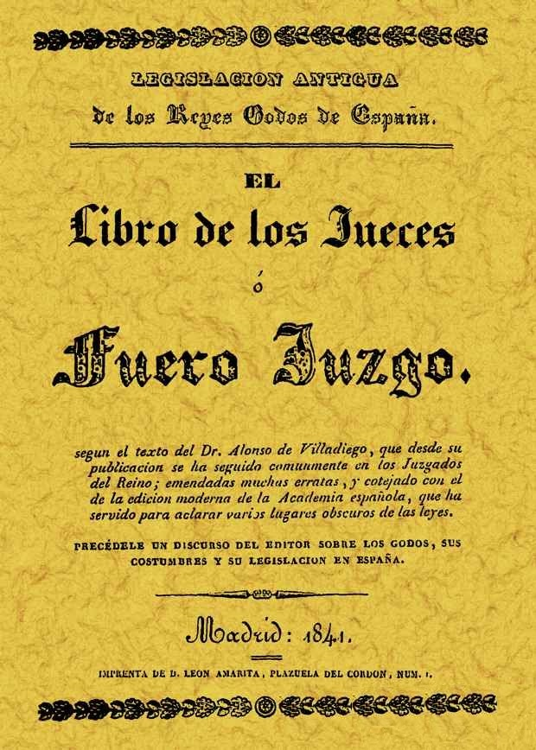
FUERO JUZGO
The Preliminary Discourse of Cadiz Constitucion said that «The Commission need only indicate what the Fuero Juzgo provides on the rights of the Nation, of the King and of the citizens regarding the reciprocal obligations of all to keep the laws».
It was the translation of the Visigothic Liber Iudiciorum, «the most perfect code the Spanish had ever had».
It was the translation in 1241, with some modifications, from Latin into Castilian by order of the King of Castile Ferdinand III.
Published with a political purpose in 1841.
Fuero Juzgo, Madrid, 1841
LEGAL CULTURE AND MEDIEVAL LEGISLATION IN THE POLITICAL MODERNITY IN SPAIN
Prof. Dr. Dr. Guillermo Vicente y Guerrero
14

Slide 15
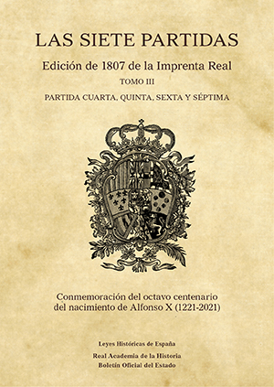
LAS SIETE PARTIDAS DE ALFONSO X
«If the kingdom is like an orchard, the people like the trees and the king is its lord, the laws and privileges are like the fences that surround it».
A work of marked doctrinal and even political intent, which, in addition to compiling the laws to be applied.
It was presented as a book of knowledge that offered biblical teachings, the sayings of the wise, natural law and other great knowledge.
Alfonso X the Wise (13th century) was more inclined to govern according to the mandates of divine law than the old fueros and liberties of an earlier legal tradition.
Las Siete Partidas, Madrid, 1807
LEGAL CULTURE AND MEDIEVAL LEGISLATION IN THE POLITICAL MODERNITY IN SPAIN
Prof. Dr. Dr. Guillermo Vicente y Guerrero
15

Slide 16
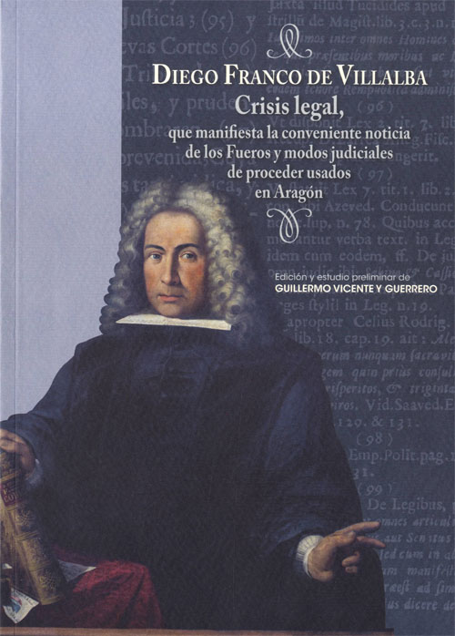
NON CASTILIAN DISCOURSE
Aragon. Crisis Legal of Diego Franco de Villalba (1710) denounced the problems of applying Castilian laws to Aragonese territory.
Catalonia. Via Fora els adormits (1734) the creation of a new Kingdom or Republic of Aragon which, under the protection of England and Portugal (to which Galicia would be added), would unite Aragon, Catalonia, Valencia, Murcia, Navarre, and the Basque Provinces.
Memorial of grievances presented in 1760 to King Charles III by the deputies of the cities of Saragossa, Valencia, Barcelona and Palma de Mallorca.
Crisis Legal, Diego Franco de Villalba, 1710
LEGAL CULTURE AND MEDIEVAL LEGISLATION IN THE POLITICAL MODERNITY IN SPAIN
Prof. Dr. Dr. Guillermo Vicente y Guerrero
16

Slide 17
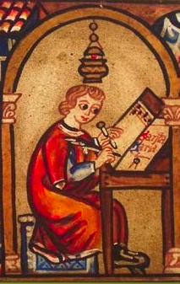
MEDIEVAL LEGAL TEXT
In the territories of the old Crown of Aragon, Navarre and the Basque Provinces were to prove essential as instruments of legitimation for any future political utopia:
  Los Fueros del Reino de Aragón y las Observancias del Reino de Aragón.
  Los Usatges de Barcelona and Las Constitutions of Catalonia.
  Los Furs of Valencia.
  El Fuero de Vizcaya.
  El Fuero General de Navarra
All these constituted the benchmark medieval legislative texts for non-Castilian Spain.
LEGAL CULTURE AND MEDIEVAL LEGISLATION IN THE POLITICAL MODERNITY IN SPAIN
Prof. Dr. Dr. Guillermo Vicente y Guerrero
17

Slide 18
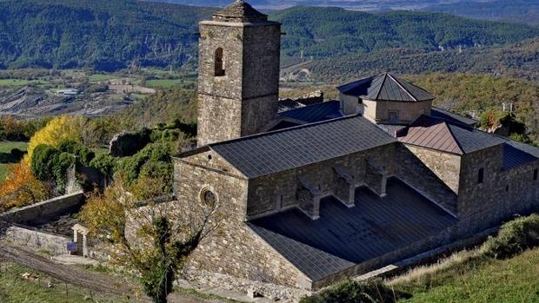
MEDIEVAL POLITICAL PACTISM
Political doctrine opposed to the absolute monarchy of Castile.
In Aragon, Navarre and Basque Country the monarchs were obliged to respect and apply the rights, privileges and liberties of these kingdoms, on the basis of a purely pactist conception of power derived, in part, from the very oath that kings had to take in order to accede to the throne.
For example, in Aragon and Navarre, the mythical Fueros de Sobrarbe explicitly included this oath, making the principle that «there were laws before there were kings» rights and liberties that expressed the voice of the Kingdom gathered in Cortes, not that of its monarchs.
Monasterio de San Victorián, Sobrarbe, s. VI.
LEGAL CULTURE AND MEDIEVAL LEGISLATION IN THE POLITICAL MODERNITY IN SPAIN
Prof. Dr. Dr. Guillermo Vicente y Guerrero
18

Slide 19
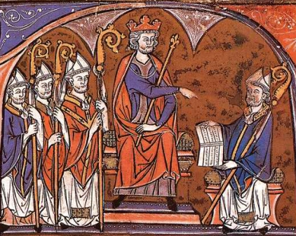
«The political antiquity of the kingdom of Aragon is the most original and admirable thing that Europe has in all its centuries». Braulio Foz, Idea del Gobierno y Fueros de Aragón, 1838.
Historical Constitution of the old Kingdom:
Fueros de Aragón of 1247, rules of common and immediate application, of great technical quality, especially directed in favour of freedom and justice, and characterised by their double rejection of both Roman and canon law.
KINGDOM OF ARAGON
Observancias del Reino de Aragón. Officially compiled by Jaime de Hospital in the 14th century and made up of judicial precedents, customs and the opinions of jurists.
Justicia Mayor de Aragón, whose historical origin dates back to 1265. This was a special judge who had to deal with disputes between nobles and between nobles and the king. His sentences had the force of law even for the monarchs.
Fueros de Aragón, Vidal de Canellas, 1247.
LEGAL CULTURE AND MEDIEVAL LEGISLATION IN THE POLITICAL MODERNITY IN SPAIN
Prof. Dr. Dr. Guillermo Vicente y Guerrero
19

Slide 20
CONCLUSIONS
  During the 19th century the medieval traditions and legal texts of the old Spanish kingdoms were frequently invoked in various utopian projects.
  These projects often moving into the realm of historical discourses of a political and indentity-based nature.
  A very important manifestation of the medieval interest was the massive editions of legal medieval texts (Fueros y Observancias del Reino de Aragón, Fuero Juzgo, Partidas de Alfonso X el Sabio…).
  Two main sources of inspiration:
    Visigothic Kingdom of Toledo. Origin of the nation. Considering the Liber Iudiciorum as the text which contained its constitutive principles.
    Medieval kingdoms. Castilian historical legislation, especially the Fuero Juzgo and the Siete Partidas; the historic Aragonese Constitution (pactism, Cortes and Justicia Mayor).
LEGAL CULTURE AND MEDIEVAL LEGISLATION IN THE POLITICAL MODERNITY IN SPAIN
Prof. Dr. Dr. Guillermo Vicente y Guerrero
20

Slide 21
CONCLUSION
  Great difficulties. Equality, was difficult to reconcile with the old medieval legislation which protected territorial differences (foralism). But Spanish law was not Castilian law. There was a very important Anti-codifying Spain, (Catalonia and Aragon) with the doctrinal support of Savigny (spirit of the people).
  Final solutions. Around the middle of the 19th century some of the principles of French doctrinarism, were mixed with the Spanish legal tradition itself, especially the Castilian one.
  In this way, the appeal to the old medieval laws continued to be present throughout the century in a legitimising key, collaborating in the formation of a new political legal model that could nevertheless be conceptualised as historical and, genuinely, Spanish.
LEGAL CULTURE AND MEDIEVAL LEGISLATION IN THE POLITICAL MODERNITY IN SPAIN
Prof. Dr. Dr. Guillermo Vicente y Guerrero
21

Slide 22
Selected primary bibliography
- ARGÜELLES, Agustín, y ESPINA, José, Discurso preliminar de la Constitución de 1812, Madrid, 1812.
-. COSTA, Joaquín, La libertad civil y el Congreso de jurisconsultos aragoneses, Madrid, 1883.
-. DURÁN Y BAS, Manuel, Memoria acerca de las instituciones del derecho civil de Cataluña, Barcelona, 1883.
-. EGAÑA, Pedro, Breves apuntes en defensa de las libertades vascongadas, Bilbao, 1852.
-. FOZ, Braulio, Idea del Gobierno y Fueros de Aragón, Zaragoza, 1838.
-. MARTÍNEZ MARINA, Francisco, Ensayo histórico-crítico sobre la antigua legislación de los reinos de León y Castilla, Madrid, 1808.
LEGAL CULTURE AND MEDIEVAL LEGISLATION IN THE POLITICAL MODERNITY IN SPAIN
Prof. Dr. Dr. Guillermo Vicente y Guerrero

Slide 23
Selected secondary bibliography
-. CORONAS GONZÁLEZ, Santos, «Las Leyes fundamentales del Antiguo Régimen», Anuario de Historia del Derecho Español, 65, 1995, pp. 127-217.
-. NIETO SORIA, José Manuel, Medievo Constitucional, Madrid, 2007.
-. PORTILLO VALDÉS, José María, Revolución de nación, Madrid, 2000.
- RUBIO POBES, Coro, Liberalismo y fuerismo en el País Vasco, Vitoria, 2002.
-. TOMÁS Y VALIENTE, Francisco, «Génesis de la Constitución de 1812. De muchas Leyes a una sola Constitución», Anuario de Historia del Derecho Español, 65, 1995, pp 13-125.
-. VICENTE Y GUERRERO, Guillermo, Las ideas jurídicas de Braulio Foz y su proyección política en la construcción del Estado liberal español, Zaragoza, 2008.
LEGAL CULTURE AND MEDIEVAL LEGISLATION IN THE POLITICAL MODERNITY IN SPAIN
Prof. Dr. Dr. Guillermo Vicente y Guerrero

Slide 24
Thank you very much for your attention
Prof. Dr. Dr. Guillermo Vicente y Guerrero
University of Zaragoza (Spain)
E-mail: gvicente@unizar.es
LEGAL CULTURE AND MEDIEVAL LEGISLATION IN THE POLITICAL MODERNITY IN SPAIN
Prof. Dr. Dr. Guillermo Vicente y Guerrero

